Slide 1
BIGTECHCOMPANY
Financial Overview
John Jerry Gordon-Mensah

Slide 2
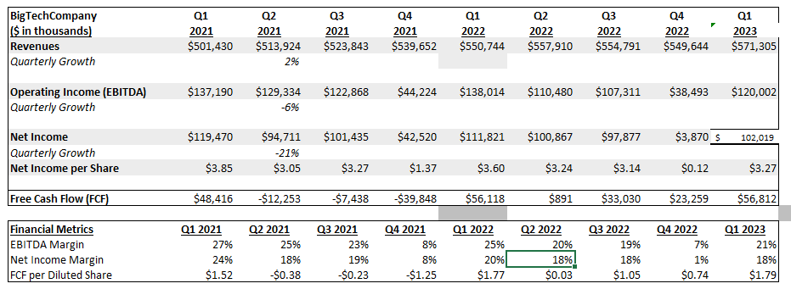
QUARTERLY PERFORMANCE

Slide 3
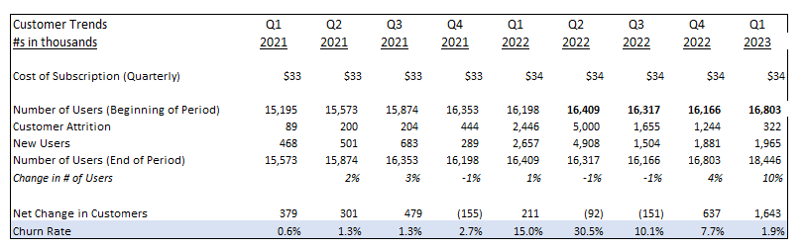
CUSTOMER TRENDS
Key Takeaways:
Customer attrition peaked in Q2 2022 due to significant churn but improved steadily through 2023, reflecting better retention strategies.
Customer growth remained strong, with new users consistently outpacing attrition, resulting in a net increase in the user base across all periods.
Churn rate improvements highlight the company’s ability to adapt to market conditions and maintain a loyal customer base despite pricing adjustments.

Slide 4
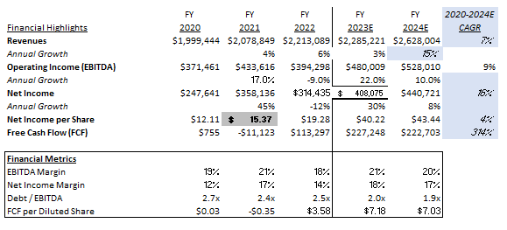
PROJECTIONS

Slide 5
CONCLUSIONS
Company Highlights
Historical revenue shows steady growth; projections indicate a 15% revenue increase in 2024.
Free Cash Flow improved significantly, with minor declines projected in 2024.
Debt/EBITDA ratio is 2.7x, well below the industry average of 4.0x, indicating strong financial health.
Areas of Concern
EBITDA margin is 19%, significantly below the industry average of 39%.
Expenses were unusually high in Q2 2022, impacting quarterly profitability.
Net Income per Share shows volatility over the years, though 2023E and 2024E project strong growth.
Recommendation
Recommend pursuing a relationship with BigTechCompany due to strong financial health, consistent revenue growth, and manageable debt levels.
Clarify the reasons behind Q2 2022 expenses and discuss strategies to improve EBITDA margin closer to the industry average.

